Slide 1
Conceptualizing & Initializing the IT PROJECTS
Aris J. Ordoñez, DIT

Slide 2
LECTURE OBJECTIVE
This lecture will describe how IT projects are conceptualized and initialized. After studying this chapter, you should understand and be able to:
Define what a methodology is and describe the role it serves in IT projects.
Identify the phases and infrastructure that make up the IT project methodology introduced in this chapter.
Develop and apply the concept of a project's measurable organizational value (MOV).
Describe and be able to prepare a business case.
Distinguish between financial models and scoring models.
Describe the project selection process as well as the Balanced Scorecard
approach

Slide 3
Project Methodology
A Methodology provides a strategic-level plan for managing and controlling IT projects. It is a template for initiating, planning, and developing an information system. Information system is the product, and not necessarily the process, of managing the project that makes them different.
Methodology recommends the phases, deliverables, processes, tools, and knowledge areas for supporting an IT project. The key word is recommends because different types of projects, such as electronic commerce (EC), customer relations management (CRM), or data warehousing applications, may require different tools and approaches.

Slide 4
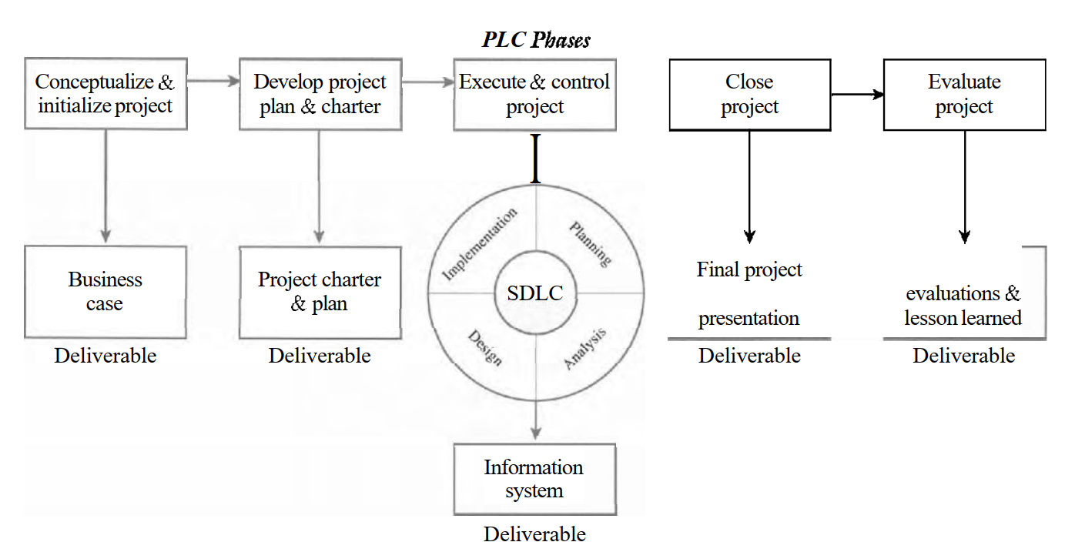
PLC Phases

Slide 5
IT Project Management Foundation
PM Processes: Initiating, Planning, Executing, Controlling, Closing
PM Objectives: Scope, Schedule, Budget, Quality
Tools: Project Management, IS Development
Infrastructure: Organizational, Project, Technical
PMBOK Areas: Integration, Scope, Time, Quality, Human Resource,
Communications, Risk, Procurement Management

Slide 6
IT Project Methodology
Methodologies provide the project team with a game plan for implementing the project and product life cycles
Methodology also provides a common language that allows the project team, project sponsor, and others within the organization to communicate more effectively
By standardizing a methodology throughout the organization, management can compare different projects more objectively because each project's planned and actual progress is reported the same way.
This will allow management to make better-informed and more objective decisions with respect to which projects get selected and whether funding should continue to support a particular project.

Slide 7
Phase 1: Conceptualize & Initialize
The first stage of the IT project methodology focuses on defining the overall goal of the project. A project is undertaken for a specific purpose, and that purpose must be to add tangible value to the organization.
Defining the project's goal is the most important step in the IT project methodology. The project's goal aids in defining the project's scope and guides decisions throughout the project life cycle. It will also be used at the end of the project to evaluate the project's success
Alternatives that would allow the organization to meet its goal must be identified.

Slide 8
Phase 1: Conceptualize & Initialize
The costs and benefits, as well as Feasibility and risk, of each alternative must be analyzed. Based upon these analyses, a specific alternative is recommended for funding.
The project's goal and the analysis of alternatives that support the goal are summarized in a deliverable called the business case. Senior management will use the business case during the selection process to determine whether the proposed project should be funded.

Slide 9
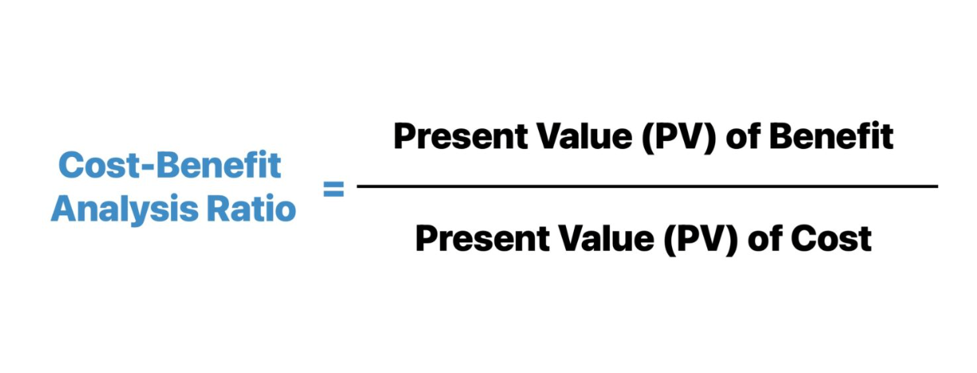
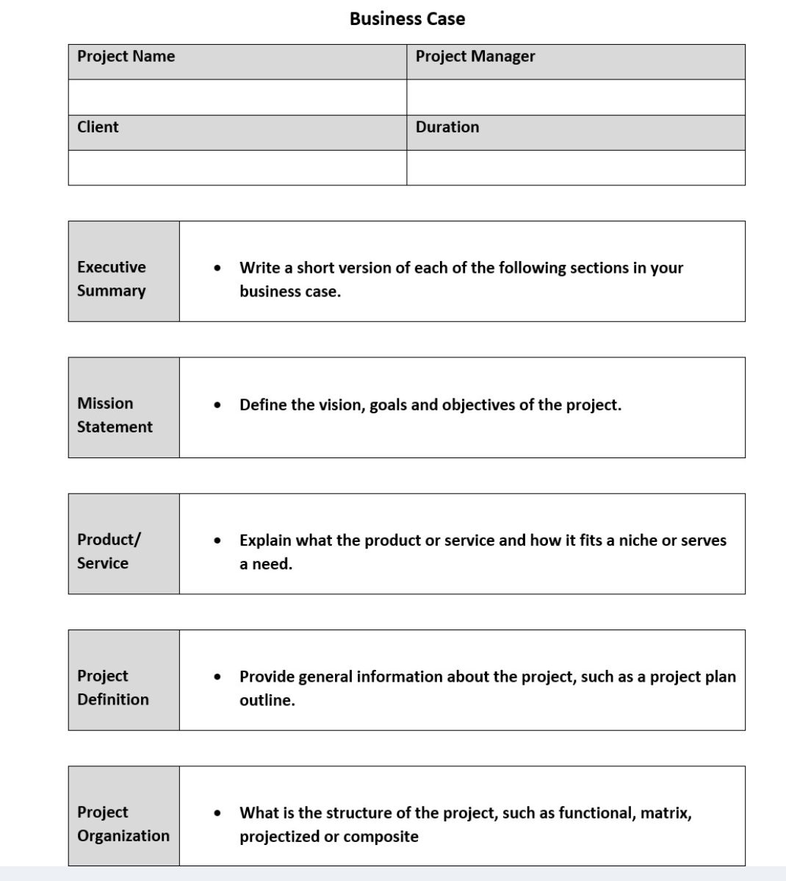
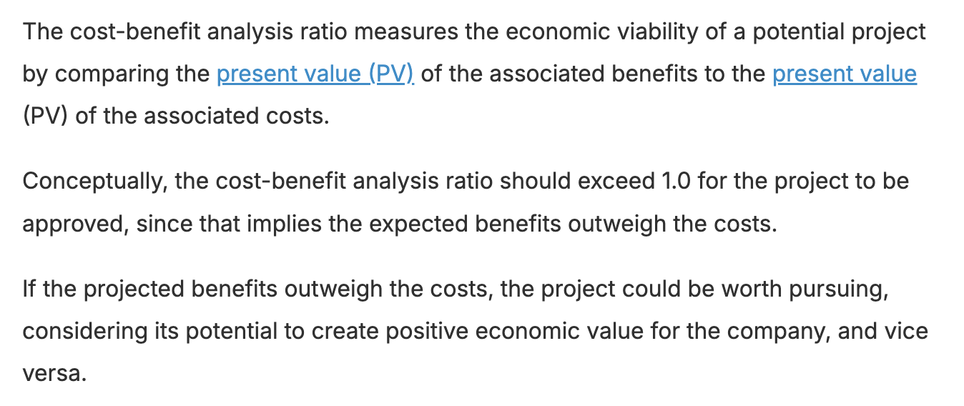
CBA and Business Case

Slide 10
Phase 2: Develop the Project Charter & Detailed Project Plan
The project charter is a key deliverable for the second phase of the IT project methodology. It defines how the project will be organized and how the project alternative that was recommended and approved for funding will be implemented.
The project charter provides another opportunity to clarify the project's goal and defines the project's objectives in terms of scope, schedule, budget, and quality standards.

Slide 11
Phase 2: Develop the Project Charter & Detailed Project Plan
The project charter identifies and gives authority to a project manager to begin carrying out the processes and tasks associated with the systems development life cycle (SDLC).
The project plan provides all the tactical details concerning who will carry out the project work and when

Slide 12
The Project Charter and Plan
The Project Charter and Plan answer the following questions:
Who is the project manager?
Who is the project sponsor?
Who is on the project team?
What role does everyone associated with the project play?
What is the scope of the project?
How much will the project cost?
How long will it take to complete the project?

Slide 13
The Project Charter and Plan
The Project Charter and Plan answer the following questions:
What resources and technology will be required?
What approach, tools, and techniques will be used to develop the information system?
What tasks or activities will be required to perform the project work?
How long will these tasks or activities take?
Who will be responsible for performing these tasks or activities?
What will the organization receive for the time, money, and resources invested in this project?

Slide 14
Phase 3: Execute and Control the Project
Carrying out the Project Plan to deliver the IT Product and managing the project’s processes to achieve the project’s goal
The project team uses a particular approach and set of systems analysis and design tools for implementing the System Development Life Cycle

Slide 15
Required project Support
Acquisition of people with the appropriate skills, experience, and knowledge
The technical infrastructure for development
IS development methods and tools
A proper work environment
Scope, schedule, budget, and quality controls
A detailed risk plan
A procurement plan for vendors and suppliers

Slide 16
Required project Support
A quality management plan
A change management plan
A communications plan
A testing plan
An implementation plan
A human resources system for evaluation and rewards

Slide 17
Phase 4: Close Project
After the information system has been developed, tested, and installed, a formal acceptance should transfer control from the project team to the client or project sponsor. Project team should prepare a final project report and presentation to document and verify that all the project deliverables have been completed as defied in the project's scope.
This gives the project sponsor confidence that the project has been completed and makes the formal approval and acceptance of the project go more smoothly

Slide 18
Phase 4: Close Project
At this time, the final cost of the project can be determined. Subsequently, the consultant may invoice the client for any remaining payments, or the accounting department may make any final internal charges to appropriate accounts.
The project manager and team must follow a set of processes to formally close the project. These processes include such things as closing all project accounts, archiving all project documents and files, and releasing project resources.

Slide 19
Phase 5: Evaluate Project Success
The final phase of the methodology should focus on evaluating four areas:
1) Postmortem, or final project review, should be conducted by the project manager and team. This review should focus on the entire project and attempt to assess what went well and what the project team could have done better. Subsequently, the lessons learned from the project team's experience should be documented and shared with others throughout the organization. In addition, the project manager and team should identify bcst practices that can be institutionalized throughout the organization by incorporating them into the methodology. As a result, the methodology evolves and better suits the organization's processes, culture, and people

Slide 20
Phase 5: Evaluate Project Success
2) The second type of evaluation should take place between the project manager and the individual project team members. Although this performance review may be structured in terms of the organization's performance and merit review policies and procedures, it is important that each member of the team receive honest and useful feedback concerning his or her performance on the project. Areas of strength and opportunities for improvement should be identified so that plans of action can be developed to help each person develop to his or her potential.

Slide 21
Phase 5: Evaluate Project Success
3) In addition, an outside third party should review the project, the project manager, and project team. The focus of this review should be to answer the following questions:
What is the likelihood of the project achieving its goal?
Did the project meet its scope, schedule, budget, and quality objectives?
Did the project team deliver everything that was promised to the sponsor or client?
Is the project sponsor or client satisfied with the project work?
Did the project manager and team follow the processes outlined in the project and system development methodologies?

Slide 22
Phase 5: Evaluate Project Success
What risks or challenges did the project team face? And how well did theyhandle those risks and challenges?
How well did the project sponsor, project team, and manager work together?
If there were any conflicts, how well were they addressed and managed?
Did the project manager and team act in a professional and ethical manner?

Slide 23
Phase 5: Evaluate Project Success
4) Lastly, the project must be evaluated in order to determine whether the project provided value to the organization. The goal of the project should be defined in the first phase of the project. In general, the value an IT project brings to the organization may not be clearly discernable immediately after the project is implemented. Therefore, it may be weeks or even months before that value is known. However, time and resources should be allocated for determining whether the project met its intended goal or not.

Slide 24
Developing a Business Case
(Group Activity)

Slide 25
Purpose of Business Case
To show how an IT Solution can create business value by:
Reducing operation’s cost
Creating new product or service
Improving customer service
Improving communication
Improving decision making
Strengthening relationship with suppliers, customers, partners
Improving processes
Improving reporting capabilities
Supporting new legal requirements

Slide 26
Steps in Building Business Case
Step 1: Select Core Team
Step 2: Define Measurable Organizational Value
Must be measurable, provide value to the organization, agreed upon, and verifiable
Identify the desired area of impact, identify the desired value of the IT Project (better, faster, cheaper?), Develop an appropriate metric, Set time frame for achieving the MOV, Verify and get agreement from the project stakeholders, Summarize the MOV in a clear concise statement or table.

Slide 27
Steps in Building Business Case
Step 3: Identify alternatives
﻿Since no single solution generally exists for most organizational problems, it is imperative to identify several alternatives before dealing directly with a given business opportunity. The alternatives, or options, identified in the business case should be strategies for achieving the MOV.
Step 4: Define feasibility and assess risk
Economic feasibility, Technical Feasibility, Organizational feasibility, other feasibilities such as legal or ethical
Risk should focus on Identification, Assessment, and Response
Step 5: Define Total Cost of Ownership
Direct or Up-front Costs (initial purchase of equipment), On-going costs (salaries), Indirect costs (unexpected costs)

Slide 28
Steps in Building Business Case
Step 6: Define Total Benefits of ownership
Increasing high value work, Improving accuracy and efficiency, Improving decision making, Improving customer service
How do you quantify benefits?
Step 7: Analyze Alternatives
Financial Models (profitability or cash flows)
Payback Period (amount of time to recover initial investment)
Breakeven (when will the business start making profit)
Return of Investment (ROI) ratio of profitability
Net Present Value (NPV) determines whether the business is profitable or not
Scoring Models (identify options with highest value of priority)

Slide 29
Steps in Building Business Case
Step 8: Propose and support the Recommendations
﻿Once the alternatives have been identified and analyzed, the last step is to recommend one of the options. It is important to remember that a proposed recommendation must be supported. If the analysis was done diligently, this recommendation should be a relatively easy task

Slide 30
Next Topic IT Project Management Processes
Thank You!

Slide 31
Develop a business case for a proposed IT Project
Create a Group of 3 members

